Slide 1

Final Thesis Project Presentation
Yun(Echo) Liu | 03035897 |May 10th, 2013
Web Design and New Media
Design | Technology

Slide 2
PROJECT OUTLINE
Why?
For Whom?
How?
Process

Slide 3
About Me | Yun Liu (Echo)
B.S.
Electrical Engineering
Multi-media
Designer/ Developer
Visual
Designer
M.A.
Telecommunication
M.F.A.
WNM

Slide 4
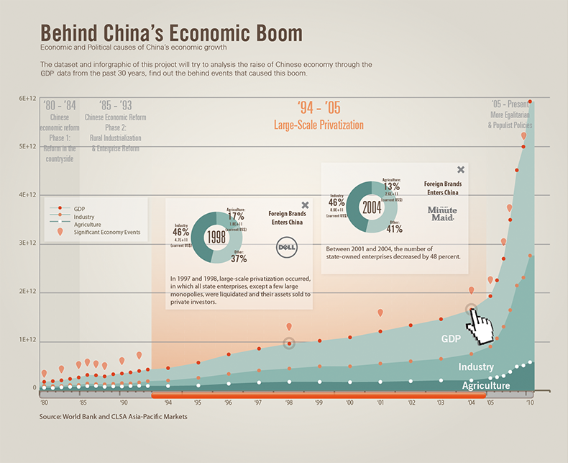

Slide 5
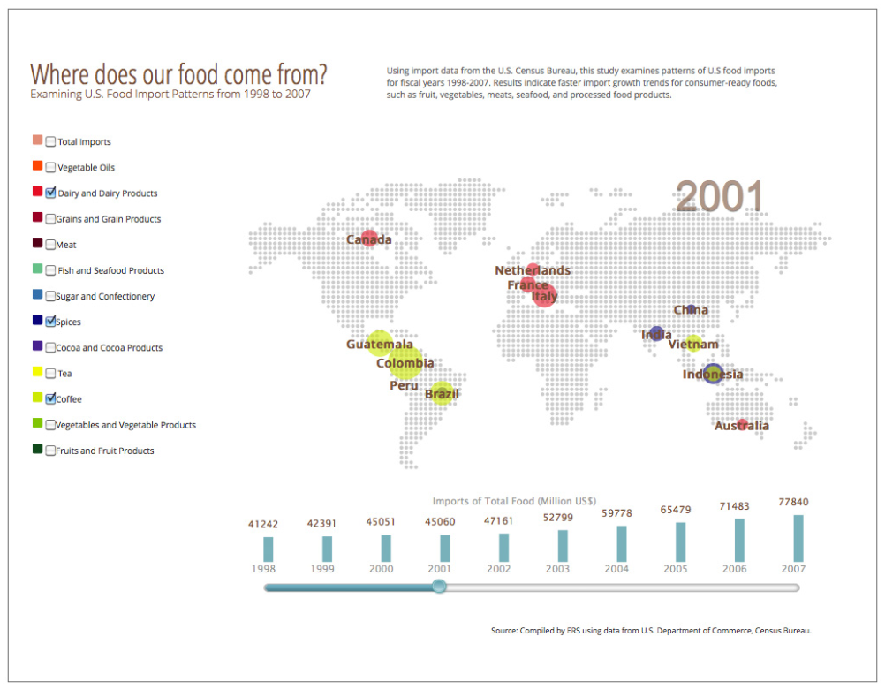

Slide 6
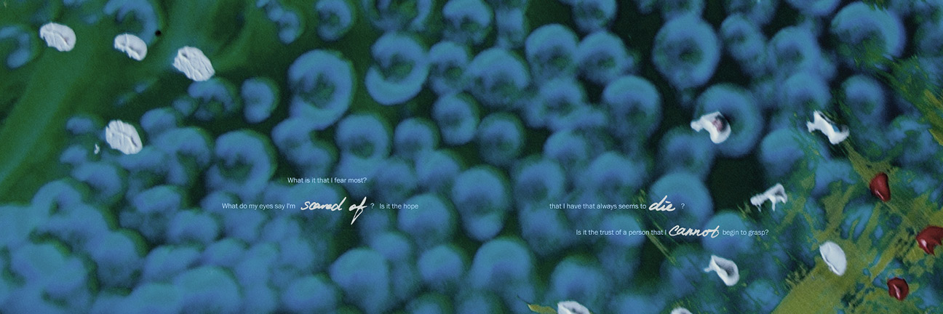

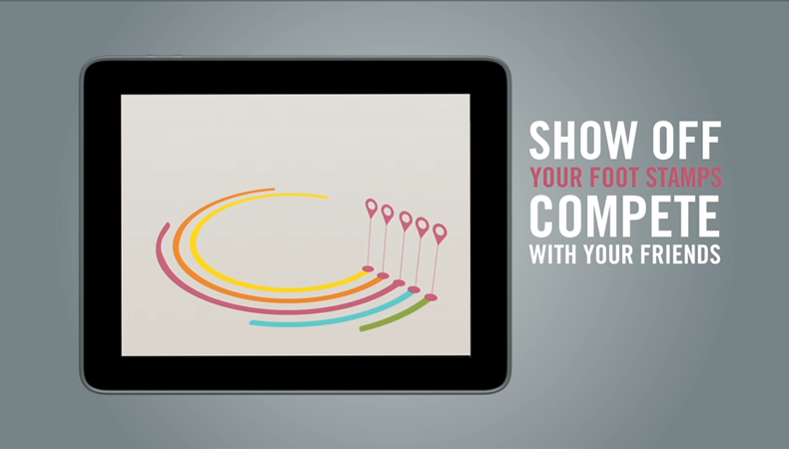
About Me | Portfolio

Slide 7
^{Why develop eMission?}

Slide 8
Project Summary | Problem
Daily Electricity Consumption Per Capita

Slide 9
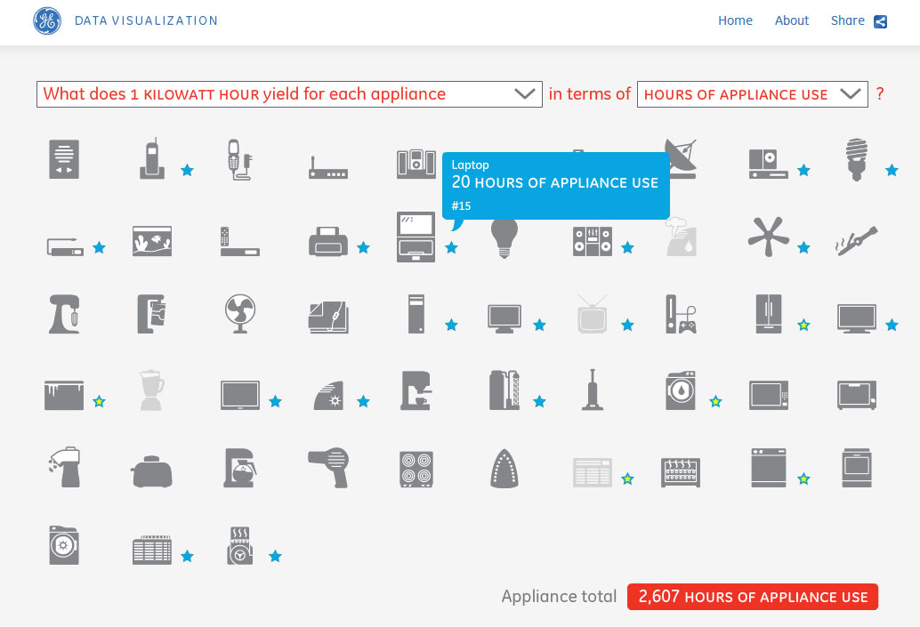
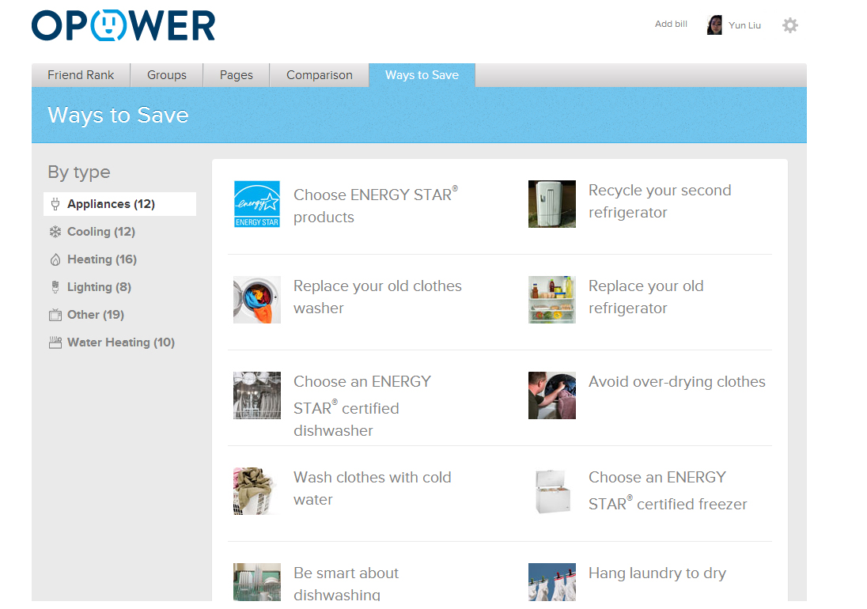
Project Summary | Competitive Analysis
^{Static information provider.}
User got overwhelmed by the long list of saving tips.

Slide 10
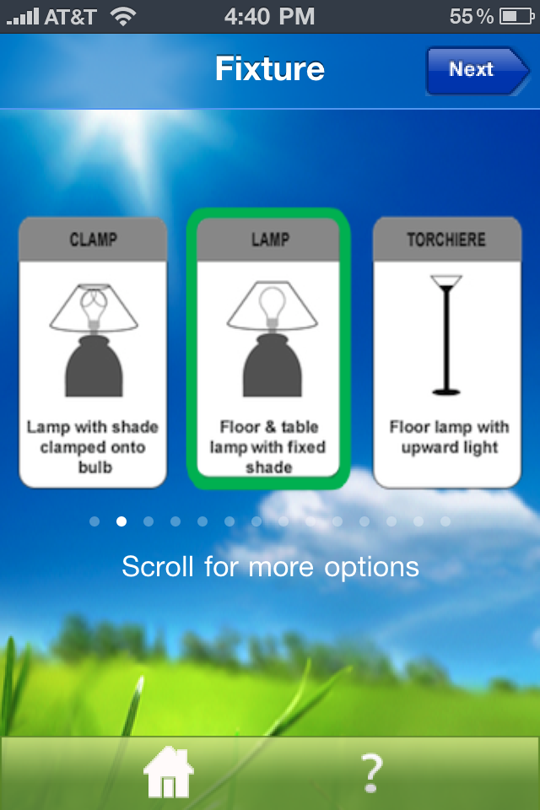
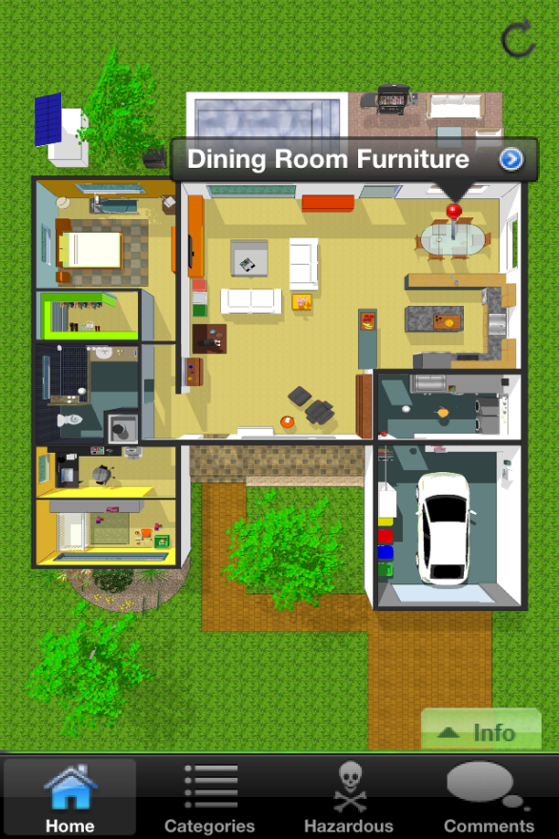
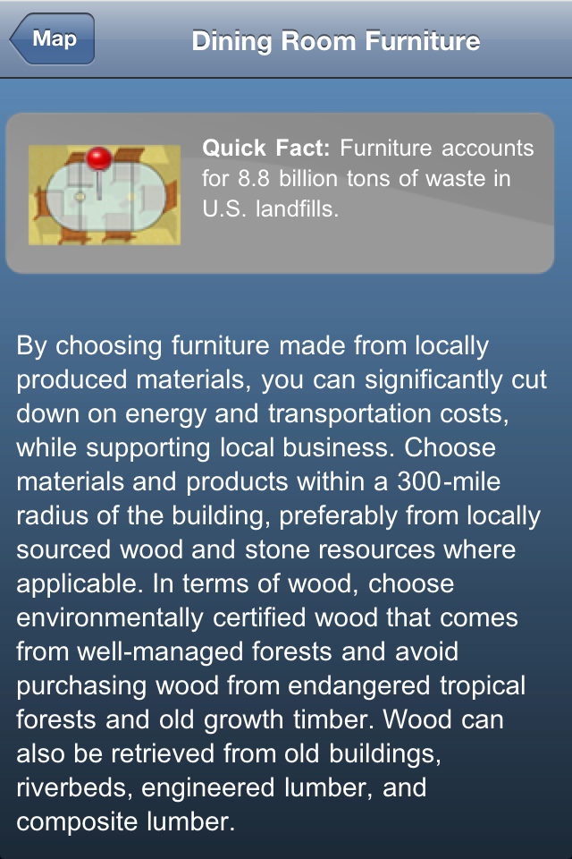
Project Summary | Competitive Analysis
No way to encourage user save energy continuously.

Slide 11
Project Summary | Solution
eMission is an interactive web app that helps user analyze their power usage and provide them customized energy saving tips.
The goal of the app is to spread the awareness of energy saving and encourage user to save energy.

Slide 12
^{Who is using eMission?}

Slide 13
Project Overview | Target Audience
Primary
Secondary
Money Saver
Environment Saver
Energy Saver

Slide 14

Project Overview | Persona

Slide 15

Project Overview | Persona

Slide 16

Project Overview | Persona

Slide 17
^{How to use eMission?}

Slide 18
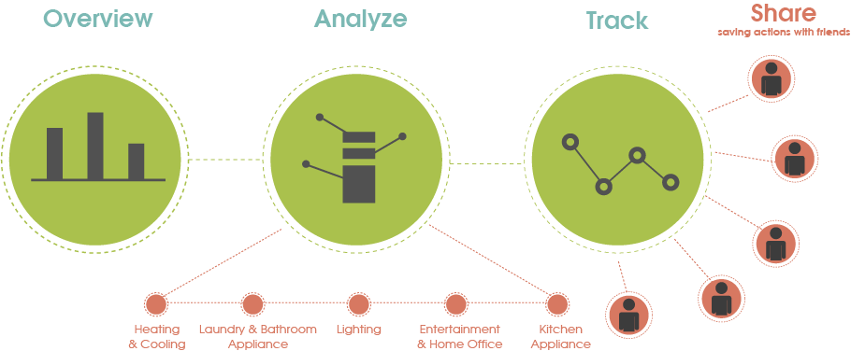
Project Overview | Interaction Mode

Slide 19
Project Overview | User Journey

Slide 20
How is eMission developed?

Slide 21
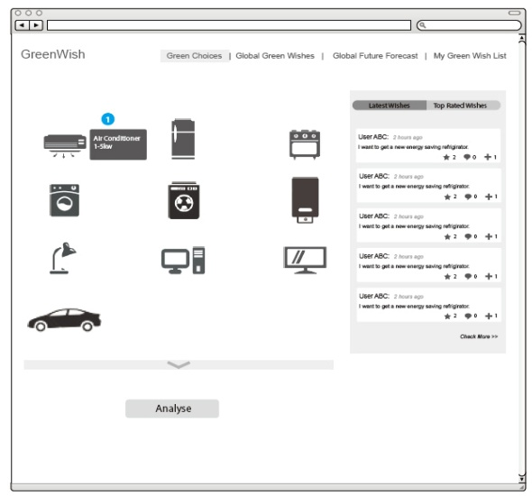
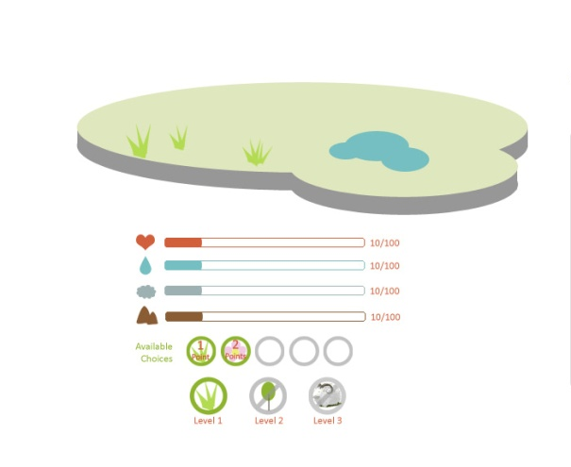
Development Process | UX
Narrow down the topic, solve one problem at a time.
Green Actions
Energy and Water Saving
Power
Saving

Slide 22
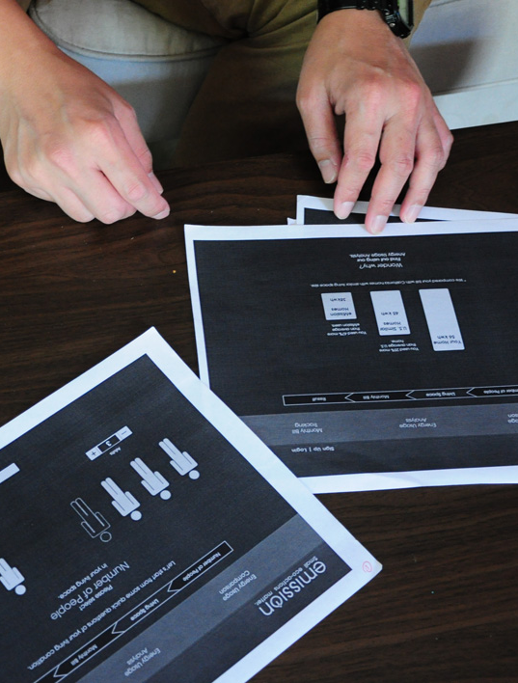
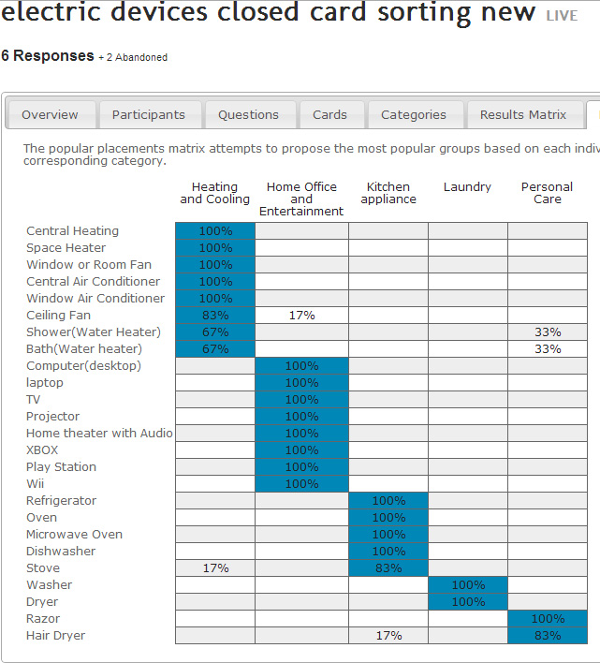
Development Process | UX Research
Interview and Surveys
Paper Prototype
Card
Sorting

Slide 23
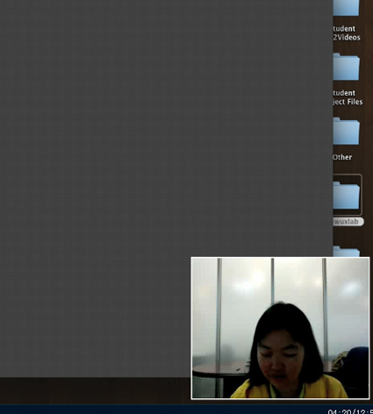
Project | User Testing
Gorilla Testing
Formal Testing

Slide 24
Development Process | Visual

Slide 25
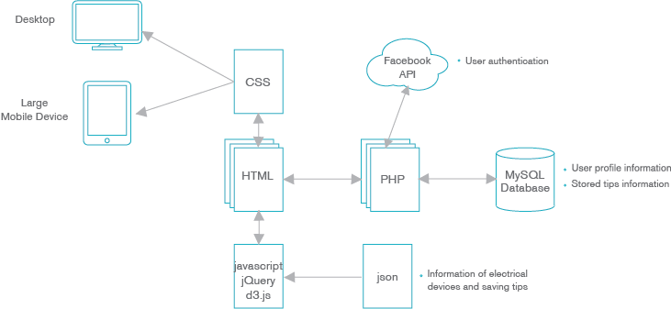
Development Process | Coding

Slide 26
Development Process | Coding

Slide 27
Next Steps
Make the site responsive for tablets and smart phones.
Continue building the backend of the site.

Slide 28
Challenges and Achievements
C

Slide 29
Thank you.

Slide 30
INTERACTION MODEL
1.
Answer Short Usage Questions
1.
Monthly Usage Track
Continuous
Impressions
Quick Start
2.
Get Estimated Result
Power Usage Analysis and Estimation
Personal Account and Social Media
2.
Compete with Friends
Sign up
for personal Account
Connect to
Facebook Friends
3.
Get Customized Saving Tips
3.
Submit New Tips or Review Existing ones
The Tips Pool Contains Original Imported Tips and New Tips Provided By user

Slide 31
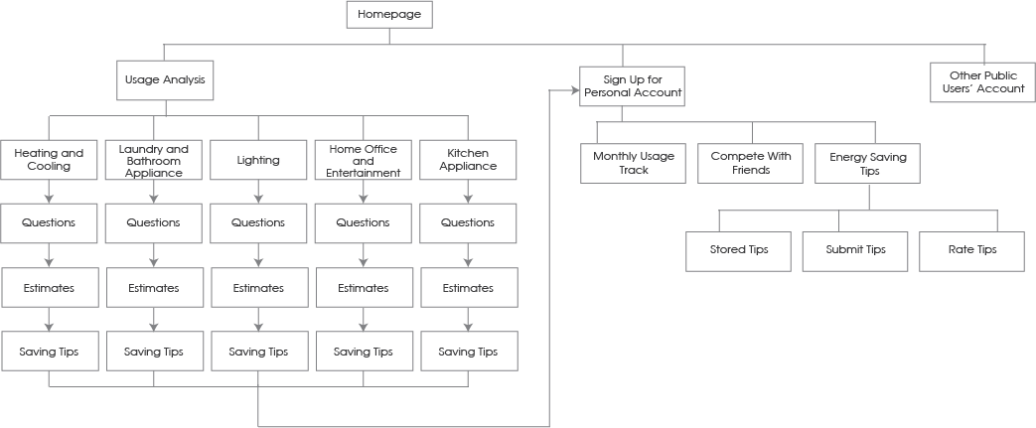
Project | IA

Slide 32
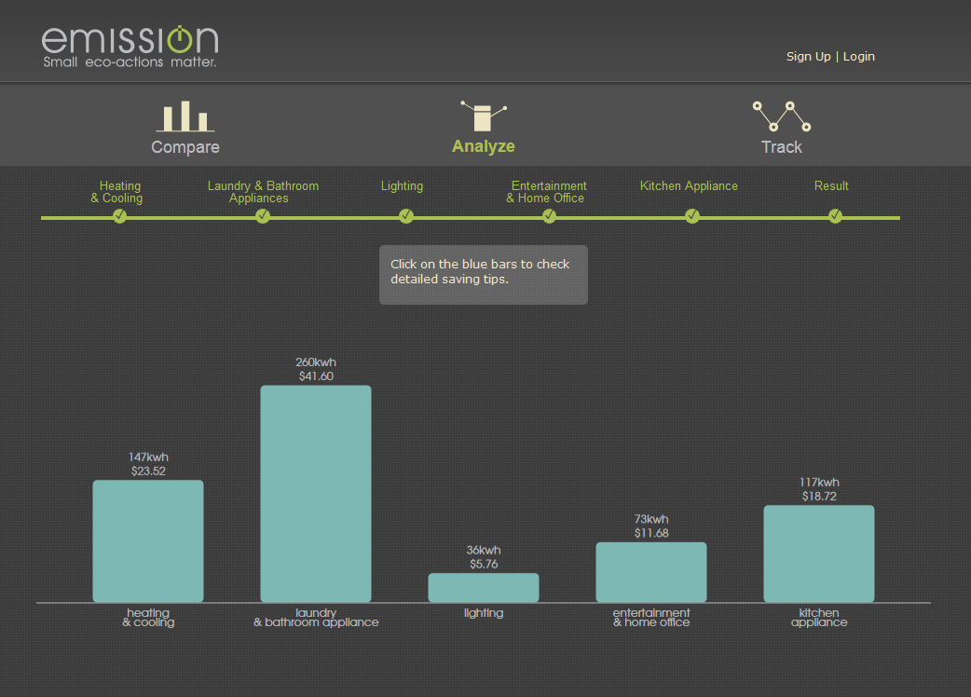
Project | UX Research
People don’t read, if it’s too subtle.

Slide 33
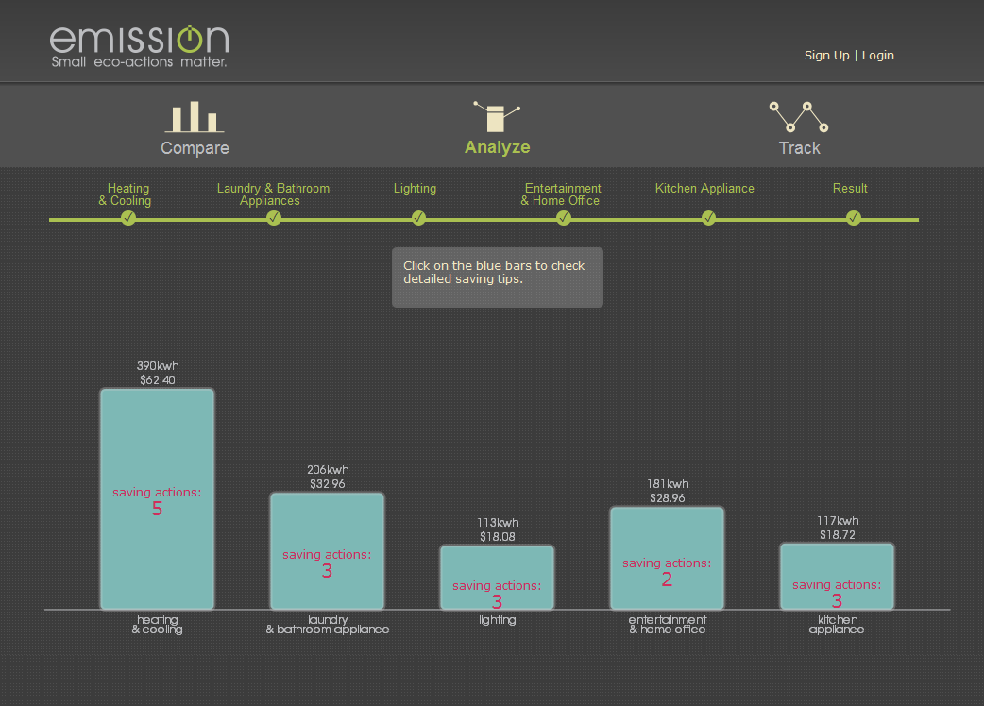
Project | UX Research

Slide 34
PROJECT OUTLINE
^{About Me}
^{Project Summary}
^{Why develop eMission}
^{Problem | Competitive Analysis}
^{Solution}
^{Who is using eMission}
^{Target Audience | Persona}
^{How to use eMission}
^{Design/Interaction Model}
^{User Concept Journey Video}
^{How is eMission developed}
^{UX | Visual | Technical}
^{Next Steps}
^{Challenge and Achievements}

Slide 35
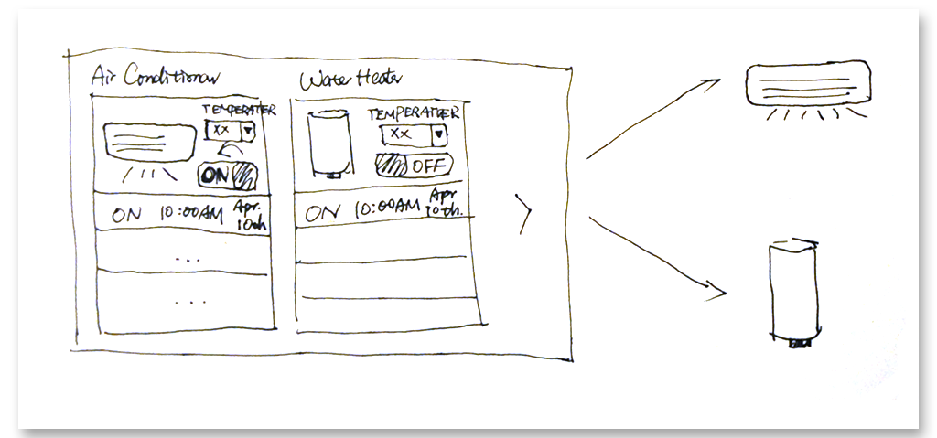
FUTURE EXPANSION
1. Use the app to control electric devices remotely.
Before go to sleep, user can double check the devices’ status, and control them remotely.
When you go out for travel, you can put devices to “OFF” status, and have them turned on and ready for you to use before you arrive home.

Slide 36
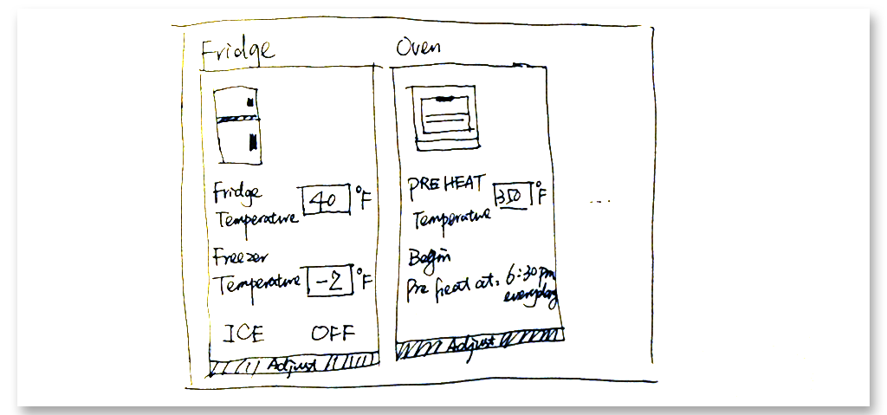
FUTURE EXPANSION
2. System learn your lifestyle and help adjust your devices’ status.

